Slide 1

“The weight is over”
Part One
Dr. Debbie Smith. EMEA Chief Medical Officer

Slide 2



2021 – It started with a question closer to home
In Zurich, John Schoonbee was presenting on metabolic health.
In London, I had a busy day of cases ahead of me.
First Disability cover claimant was a 44 yr. old female, off work 10 months. No COVID test but summarised as a Long COVID claim. Main symptoms of breathlessness, poor exercise tolerance, low mood. Past history included impaired glucose tolerance, mild OA.
CMO input was sought for review of her capacity for either rehab or work. On page 296 there was mention of a height 160cm, weight 137kgs.
Hang on… 296 pages in and it’s the first mention that their BMI is 53?
Nothing in their list of current conditions or illnesses!
How often does this happen – that BMI is invisible to us?
How often is it invisible to you?

Slide 3
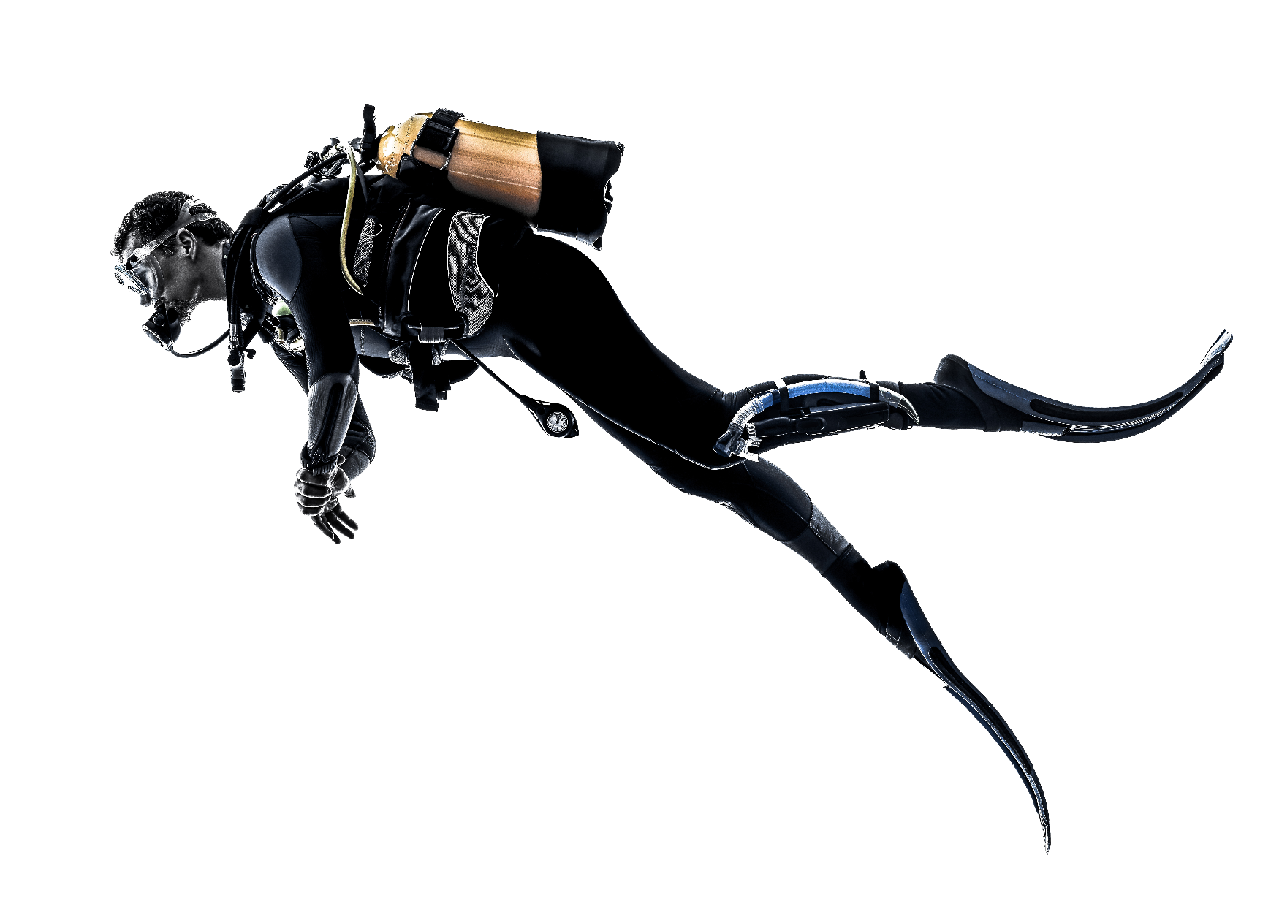

Swiss Re IP Claim Deep Dive key stats
Large sample size n=277
Reviewed by team of 6 doctors, plus clinical team, claims assessors, and actuaries.
Randomised sample, claim durations up to 5 years
1% Underweight
11% Normal range
10% Overweight
18% Obese
60% No information available
Further drill down into 12+ month IP claim cohort.
Clinician analysis of medical histories to detect extent of obesity as a claim driving factor.

Slide 4
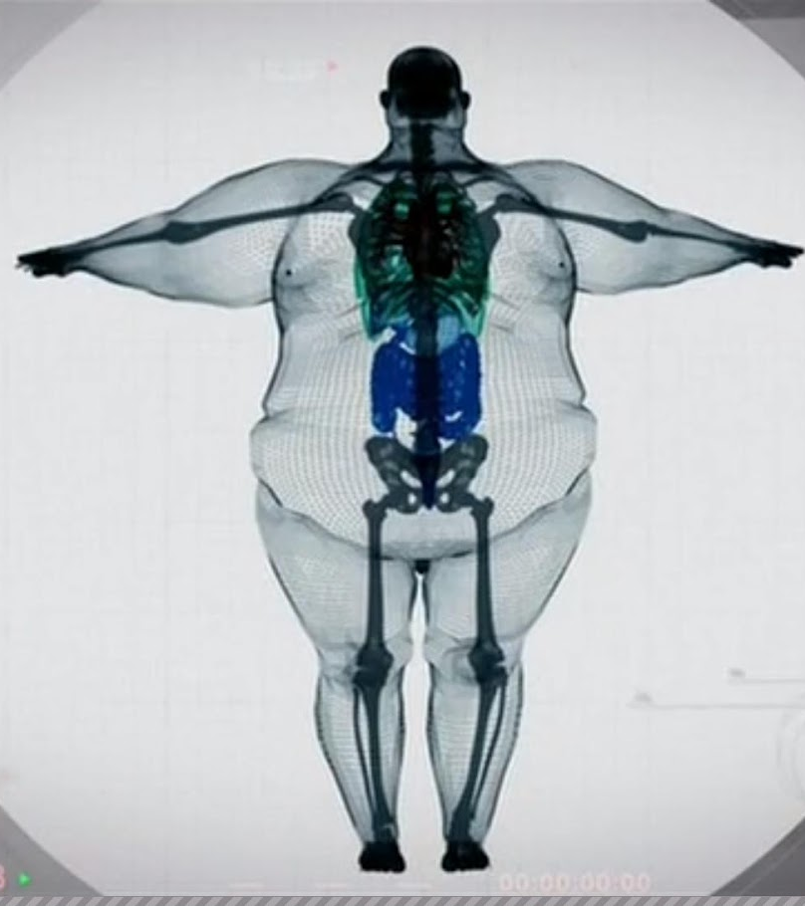
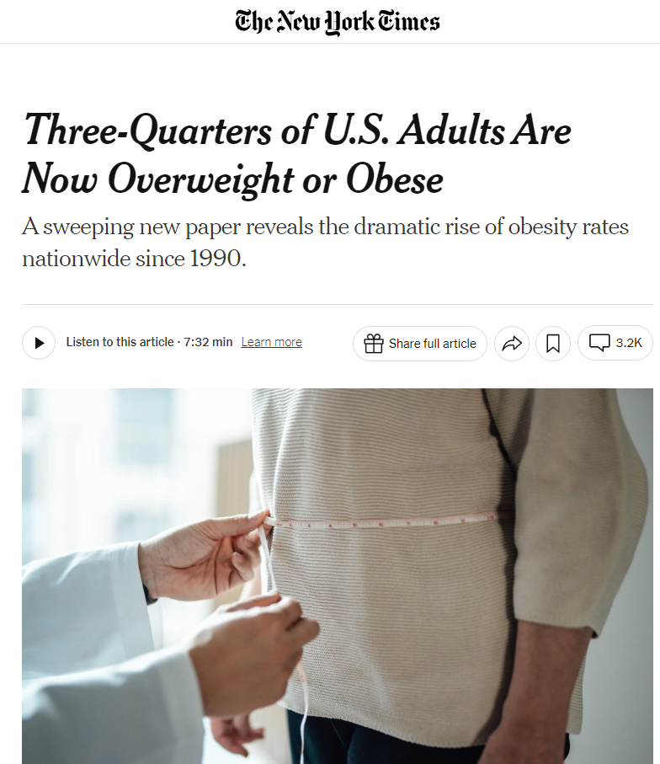
Setting the scene – International trends
This Photo by Unknown Author is licensed under CC BY-NC-ND

Slide 5
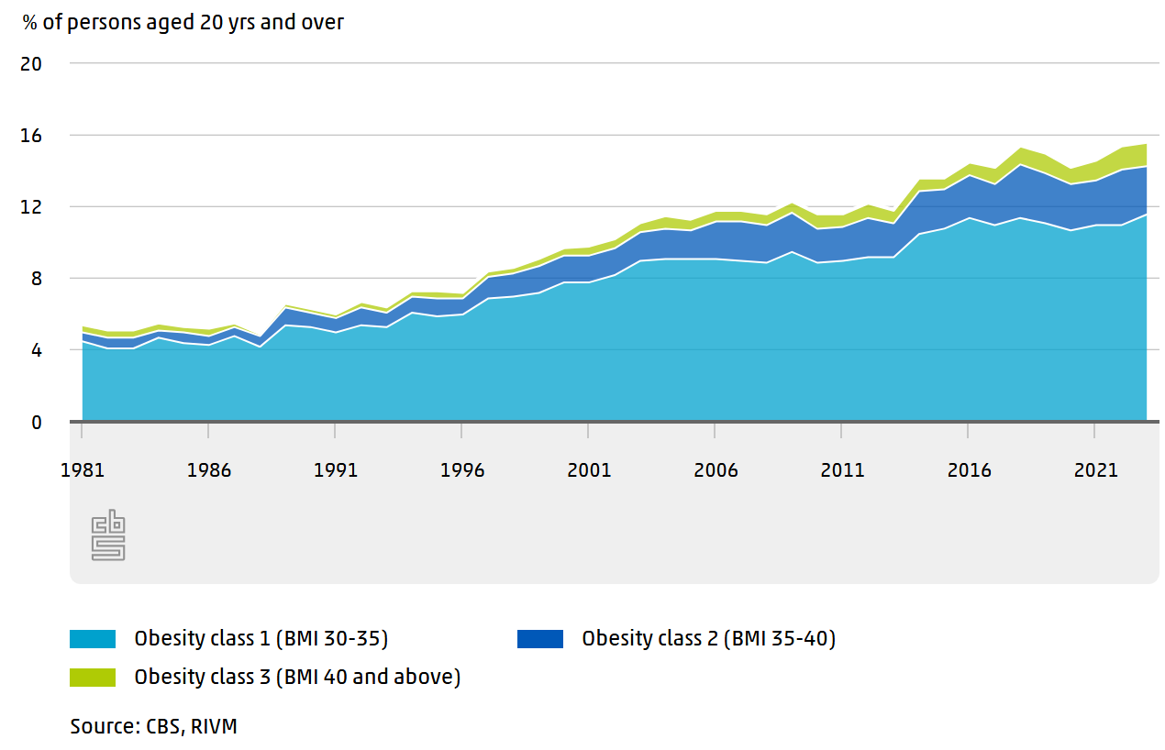
Local trends
This Photo by Unknown Author is licensed under CC BY-NC-ND
Notes:
Annual health surveys here indicate a rising trend, but positioning against other European countries is more favourable.

Slide 6

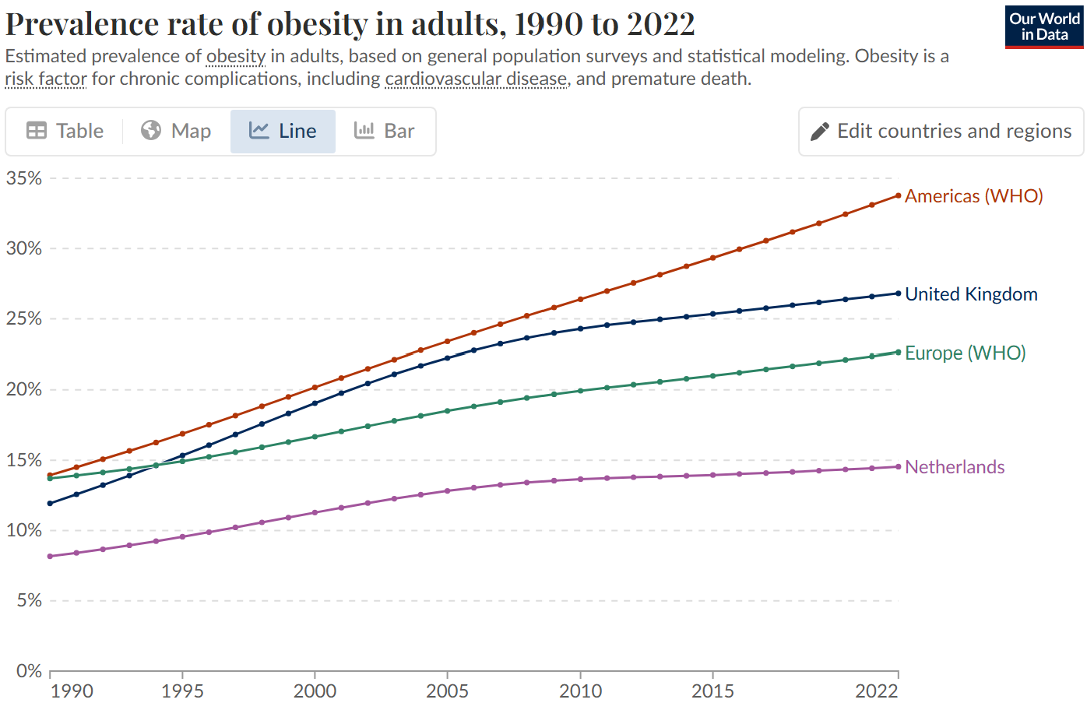
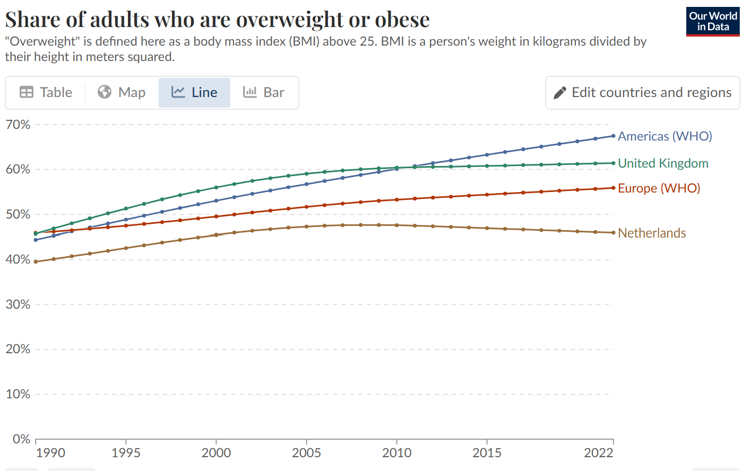
Comparative Obesity Rates in Adults – 1990 to 2022 Share of adults that are obese Share of adults that are overweight or obese
Source: WHO, Global Health Observatory
OurWorldlnData.org/obesity

Slide 7

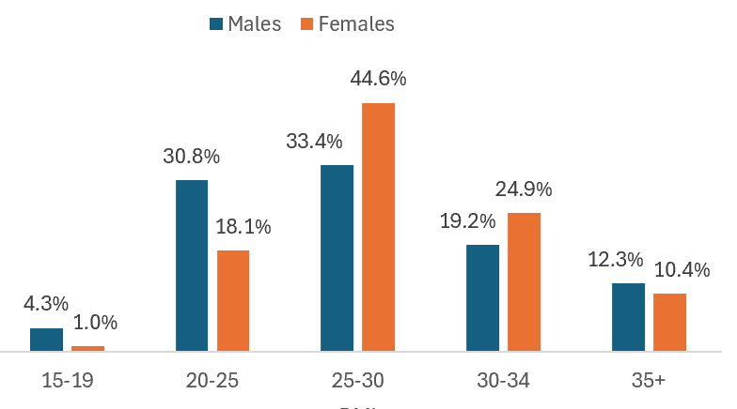
Is the insured cohort less affected? US population versus Swiss Re data
1.2% variance insured to general population
Overweight +
Obese
Combined “above normal range” weight = 72.4% (insured) 73.6% (total population) (2018).
Source: CDC data and projected using Swiss Re’s CMC.

Slide 8

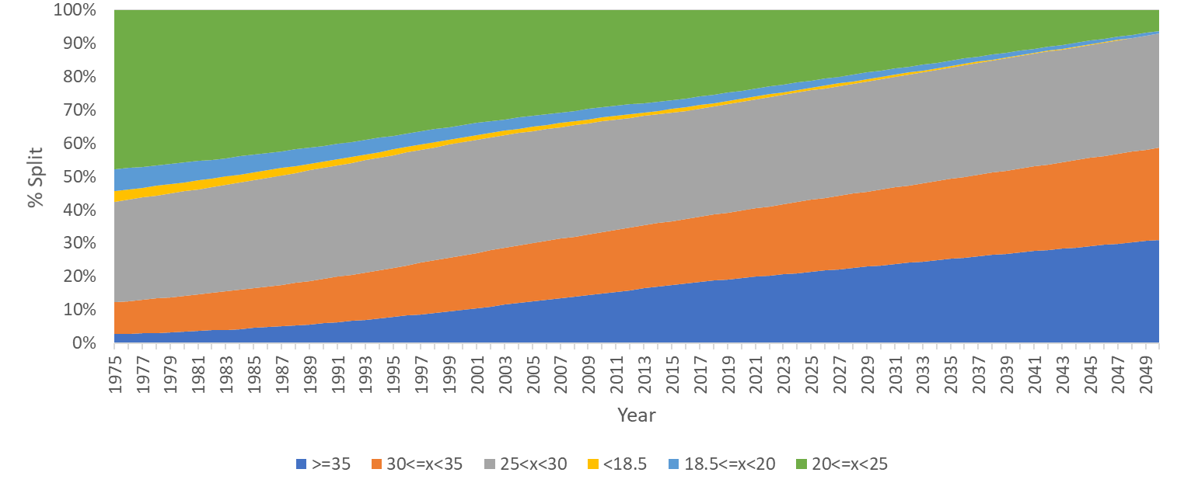
Projecting historical BMI population distribution trends into the future (in a pre GLP1 agonist era)
Distribution Of BMI in the US over time
Projected
23.7%
6.2%
0.8%
1.7%
34.3%
38.1%
27.7%
21.3%
15.2%
31%
American Obesity society prediction that “Obesity will rise to 60% by 2030 if there are no new interventions”.
Obese + Overweight
= 93.8%
Source: Lancet data.

Slide 9
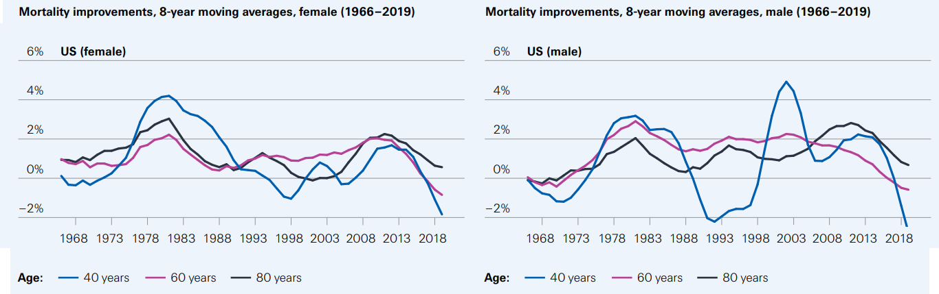
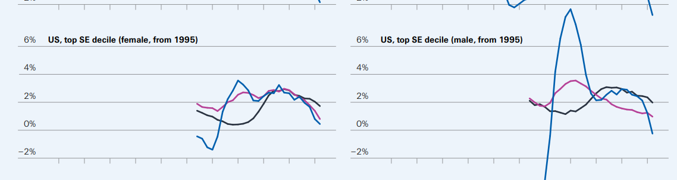
US population mortality improvement trends(with overlaid top SE decile)
The future of life expectancy May 2023, Swiss Re Institute

Slide 10

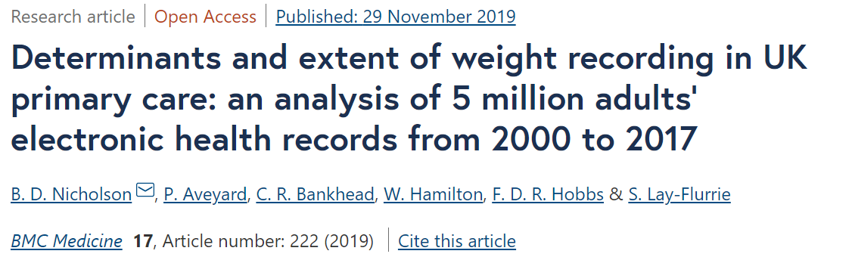
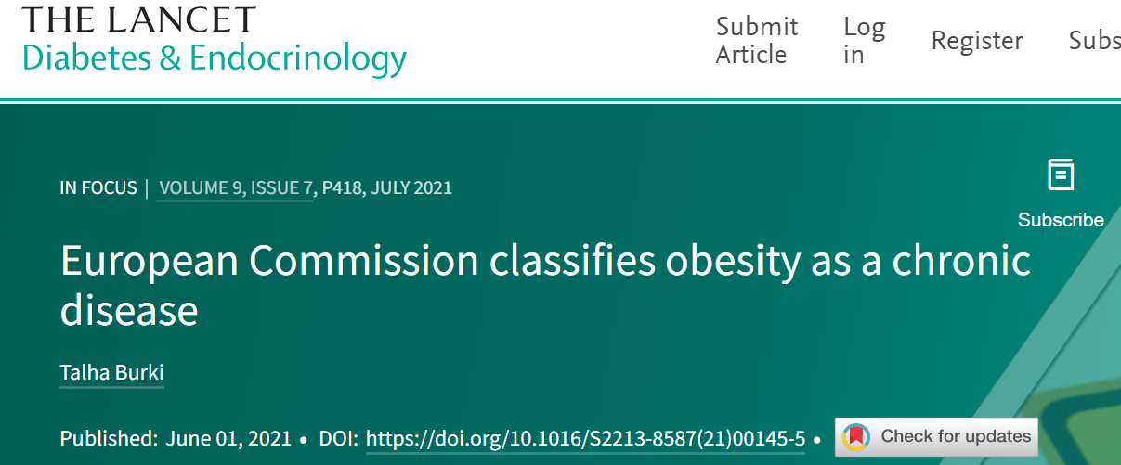
A lack of visibility in UK clinical records
Swiss Re Income Protection Claim Deep Dive found that:
75%
of obese claimants did NOT have obesity listed as a condition in their GP records

Slide 11
Post pandemic impacts upon obesity data in health records
Family doctors in UK register obese patients in return for QOF points
In 2022 the Health Survey for England data showed 29% obesity prevalence
In 2022 QOF obesity registrations were 11.4%
The BMA response to a NICE consultation said: ‘We cannot support these indicators. Unless a patient is morbidly obese, GPs do not generally play a major role in this process”
Swiss Re IP Claim Deep Dive – Only 1 in 5 obese claimants had documented nutritional advice or referral to obesity services.

Slide 12


To summarise so far
Prevalence has been rising year on year
Identification of applicants with high BMI at claim was suboptimal
Long-term forecasts are concerning
We also need to consider:
Accuracy of our current
data and disclosures

Slide 13


UK Disclosure versus verified data n=260
BMI disclosure analysis by gender
20%
were not accurate with their BMI disclosure
Source: Swiss Re data

Slide 14

Global obesity challenges

Slide 15
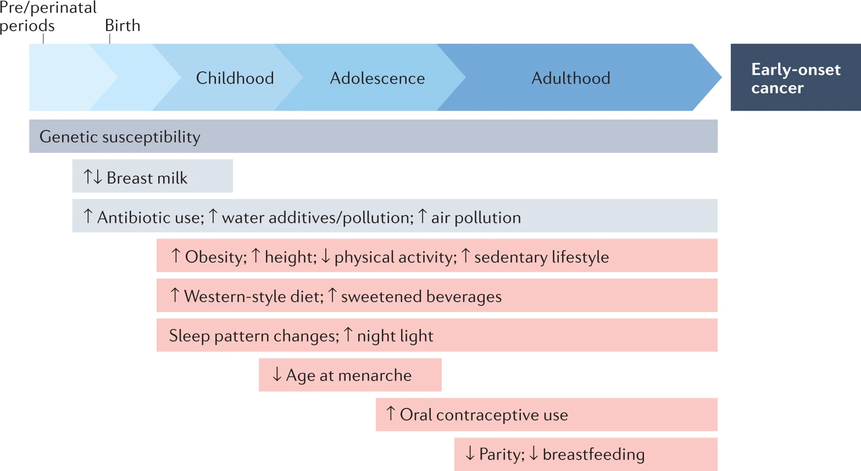
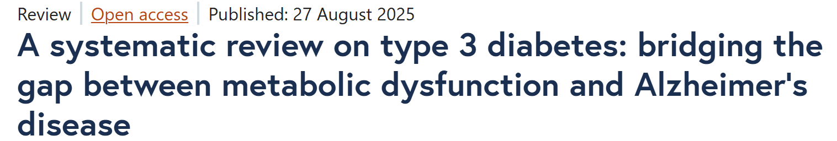
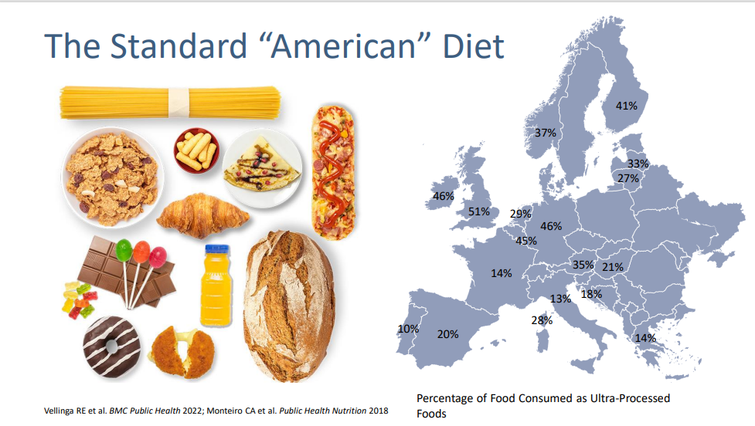
Environment

Slide 16
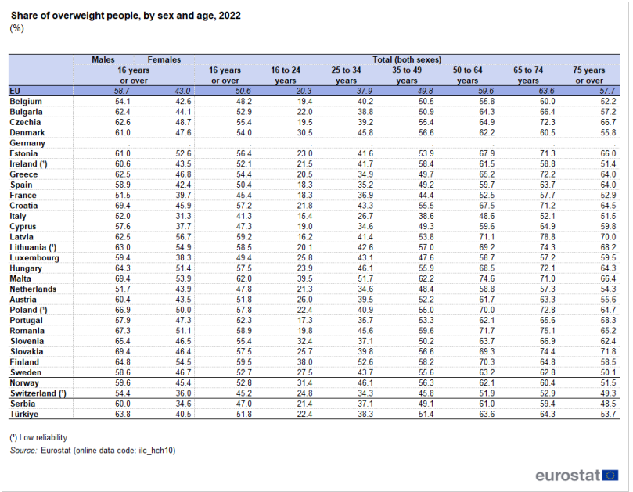

Is weight gain inevitable by age?
Age | Overweight %
16-24 | 21.3%
25-34 | 34.6%
35-49 | 48.4%
50-64 | 58.8%
65-74 | 57.3%
Notes:
Overweight and obesity - BMI statistics - Statistics Explained

Slide 17
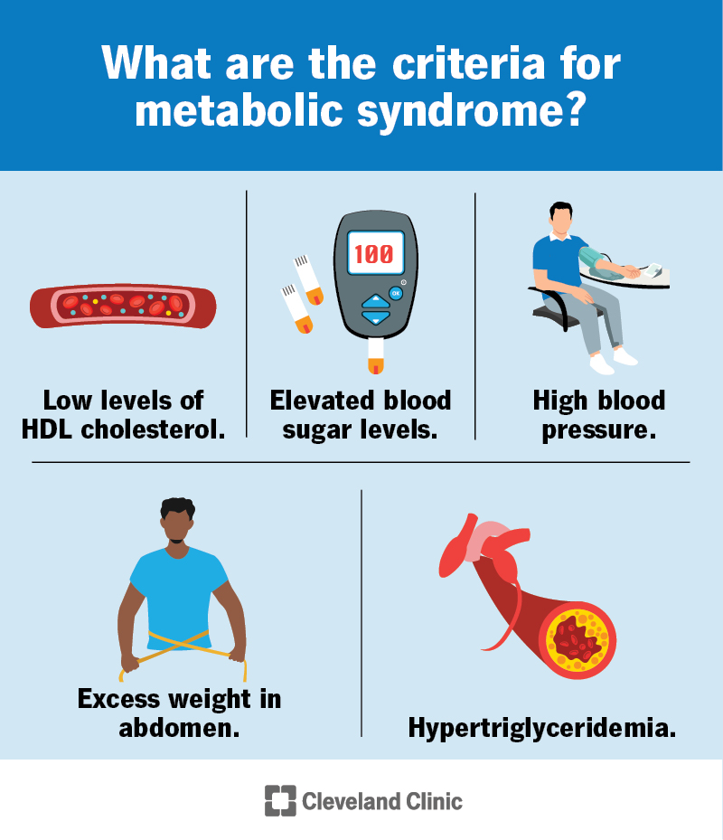
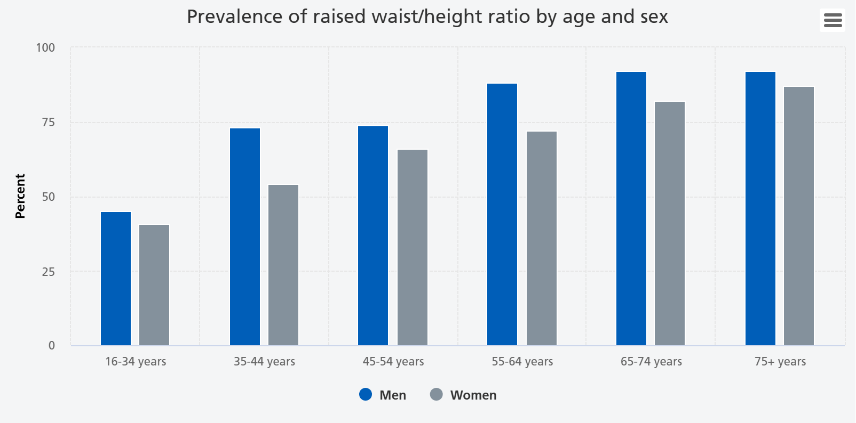
Obesity rarely occurs in isolation
“Insulin resistance syndrome”
Top 3 impairments on our US fac book are;
Obesity
Diabetes
High cholesterol
Notes:
we know 70% of us adults overweight or obese, 40% obese
half us adults diabetic or prediabetic
1/3 have met syndrome (i.e. 3 of the 5 criteria)
BUT 93% of us adults have some evidence of IR
China is not far off. only 14% “met healthy”
top 3 impairments uw on our fac cases obesity, diabetes, cholesterol

Slide 18

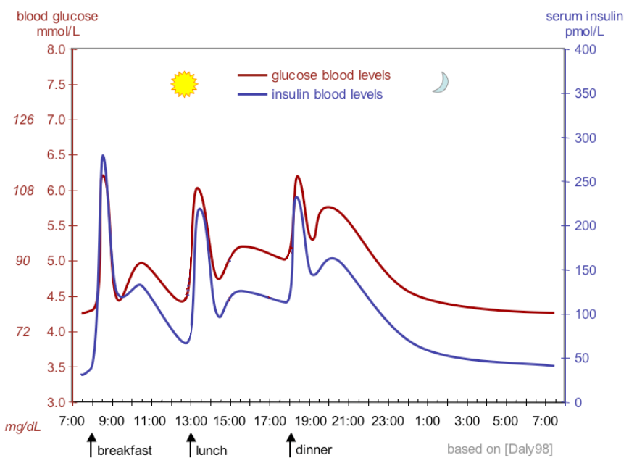
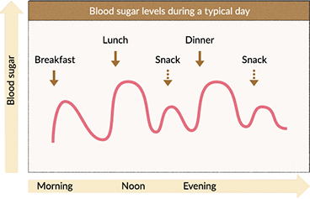
Obesity doesn’t exist in isolation More insulin drives weight gain
hyper- insulinemia
insulin resistance
Notes:
So what happens if it becomes more common to eat more often and with more sugar containing foods
Then you can see that the blood sugar levels remain high for much more of each day
Over time the cells become more resistant to the insulin, so more is released to try and keep the blood sugar within that normal range
Insulin “switches on” cells for the uptake of sugar
Eventually the insulin becomes less effective as the cells become resistance to its actions, so insufficient glucose is taken up into the muscle, fat or liver cells and it stays in the blood.
So the balance is lost – your blood sugars remain high, and if you’re already diabetic then you’ll keep increasing your insulin in a losing battle against the insulin resistance
If you’re not already a type 2 diabetic then you will in time unless you reverse the eating habits
So what does this mean in terms of developing diseases?

Slide 19
Why has the Calories in, Calories Out View failed
That Overeating CAUSES Obesity
eat
less
Ubiquitous, energy dense
tasty food
Increased
body fat
Overeating
move
more
Physical inactivity
(TV, computer, etc)
Credit; Dr. John Schoonbee. MD Global Chief Medical Officer, Swiss Re​
Dr. David Ludwig, MD PhD Professor of Pediatrics at Harvard Medical School and Professor of Nutrition at Harvard School of Public Health​

Slide 20
Calories in, Calories Out View
Late 20th Century
“When people are allowed to eat from ranges of high-fat or high-sucrose foods, passive overconsumption only occurs with fat. It follows that fat promotes overconsumption while sucrose probably prevents it” — J Am Diet Assoc 1997; 97:S63-9
“The evidence intriguingly suggests that it is specifically an increased intake of sugars . . . rather than of complex carbohydrates that tends to dilute fat energy” — AJCN 1995; 62:264S-273S

Slide 21
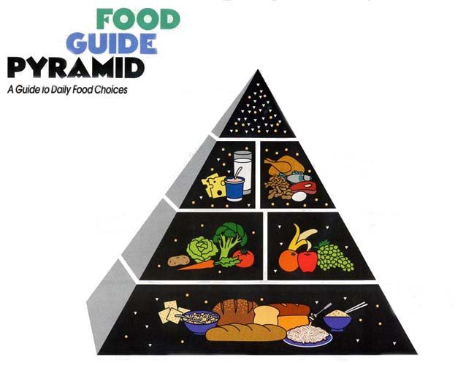
Calories in, Calories Out View
And yet the myth continued - Late 20th Century
Nutrients
Fat
Carb

Slide 22
Calories in, Calories Out
Late 20th century

Slide 23
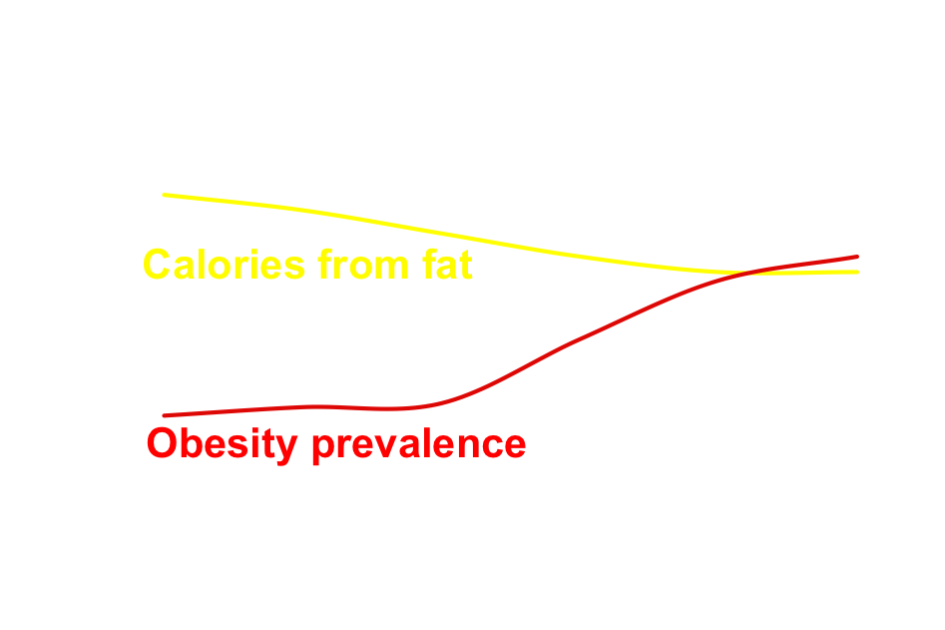
Trends in Dietary Fat It’s still not working!
Calories from carb
Percent
Year

Slide 24
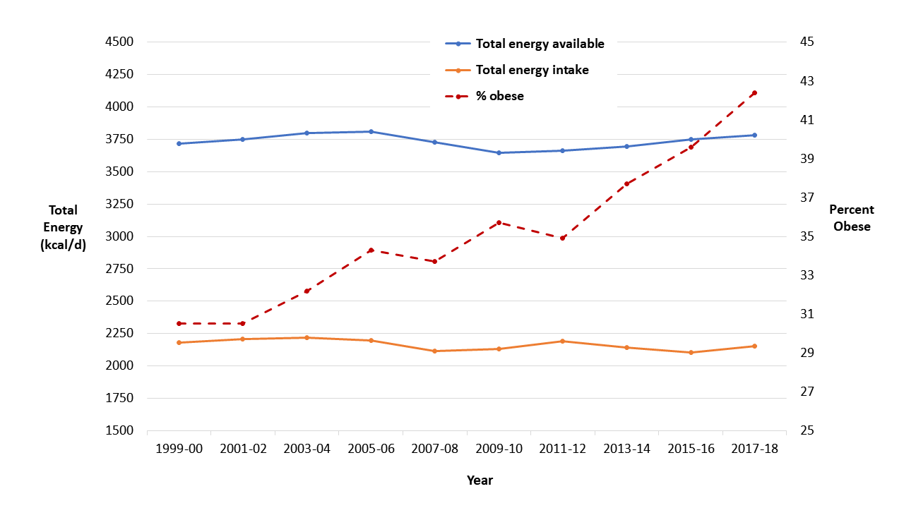
Trends in Calorie Consumption
It’s still not working …even though we are eating less
Statistically significant decrease since 2000
Mozaffarian. AJCN 2022 Apr 23:nqac075

Slide 25

Cause Versus Effect
Adolescent growth spurt
Increased
body fat
Overeating
Growth

Slide 26
Carbohydrate-Insulin Model
The process of getting fat DRIVES overeating
Processed, fast-digesting carbs
Insulin
Increased
body fat
Overeating

Slide 27
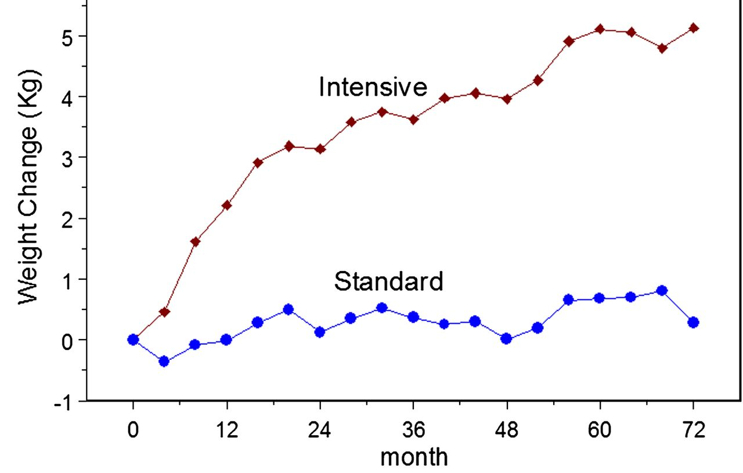
Insulin & Body Weight
ACCORD Trial
8,929 participants with T2DM
Intensive treatment (with more insulin) versus standard treatment
Diabetes Care 36:2162-68

Slide 28

Are all carbs equal?
Effects of Fast-Digesting Carbs in Rodents Differences in body composition
Adiposity (%)
p < .01
High GI
Low GI
Pawlak. Lancet 2004, 364:778-85

Slide 29
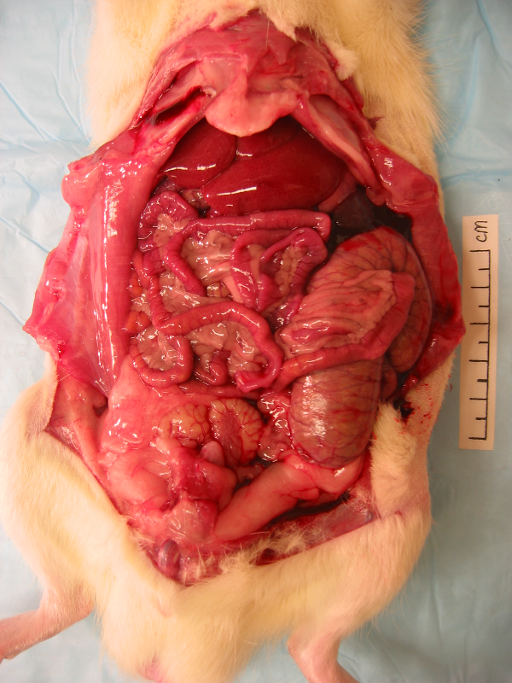
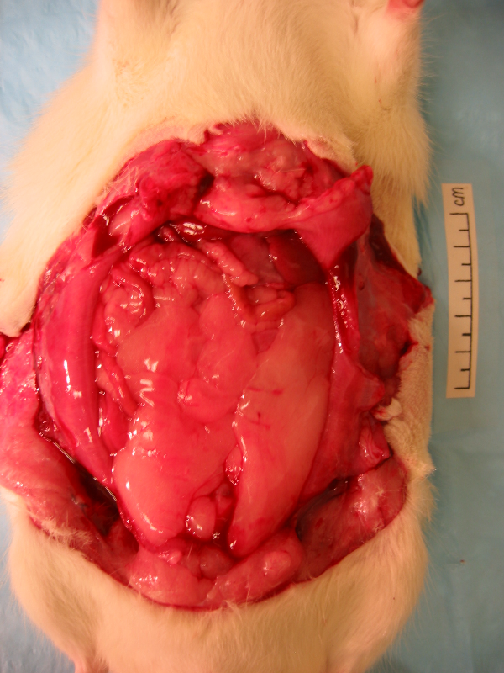
Effects of Fast-Digesting Carbs in Rodents Differences in body composition
CANNOT be explained by calories in, calories out:
⬇️ Energy intake
⬇️ Lean mass
⬆️ Fat mass
Low GI
High GI
Pawlak. Lancet 2004, 364:778-85

Slide 30
Meta-analyses of Low-Fat Diets in Humans INFERIOR to all other comparison diets
• Medium-fat Mediterranean diets
Nordmann AJ. Am J Med 2011, 124:841-51
• Low-Carbohydrate diets
Sackner-Bernstein J. PLoS One, 2015 20;10:e0139817
• Very low-carbohydrate diets.
Bueno NB. Br J Nutr 2016, 115:466-79
• Ketogenic (ultra-low carbohydrate) diets
Mansoor N. Br J Nutr 2013, 110:1178-87
• All higher-fat diets
Tobias DK. Lancet Diabetes Endocrinology 2015, 3:968-79

Slide 31
Markers of high(er) risk of insulin resistance
Waist circumference > half your height
Pre-diabetes or Type 2 diabetes
High triglycerides
High blood pressure

Slide 32

Findings of the study

Slide 33
Swiss Re IP Claim Deep Dive key stats
n=277
Reviewed by team of 6 doctors, clinical team, claims assessors, and actuaries.
Unselected sample, claim durations up to 5 years
1%
Underweight
11% Normal range
10%
Overweight
18% Obese
60% No information available
Further drill down into 12+ month IP claim cohort.
KEY
FINDING
From analysing co-morbidities, we concluded that in 18.4% of long-term IP claims obesity was the factor regarded as the PRIMARY DRIVER of claim – but wasn’t listed as a health condition in 75% of cases.

Slide 34
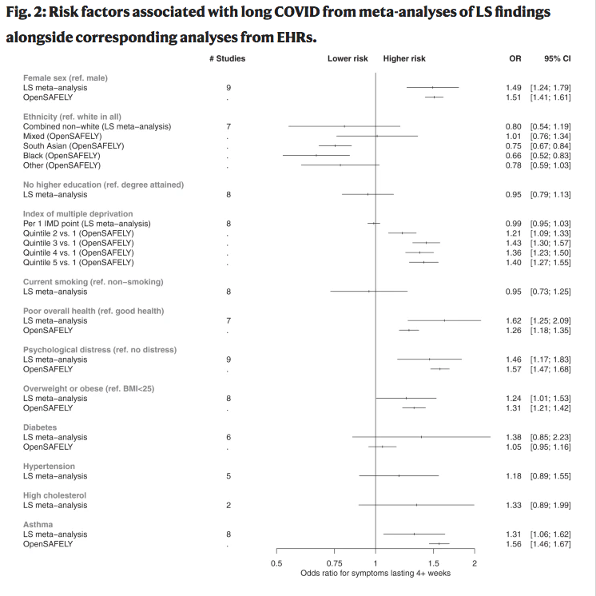
Long COVID correlations with obesity
OBESITY a hidden factor in claim
No BMI data available
Swiss Re IP Claim Deep Dive – Long COVID & BMI
Source: https://www.nature.com/articles/s41467-022-30836-0.
Swiss Re | LUCID 2023 | Obesity: The hidden pandemic

Slide 35
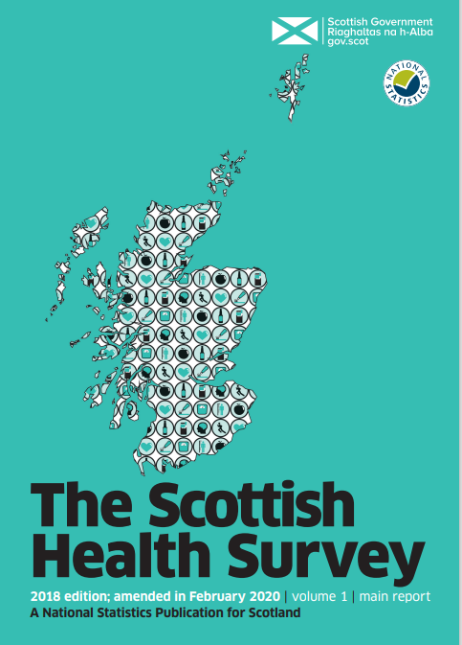
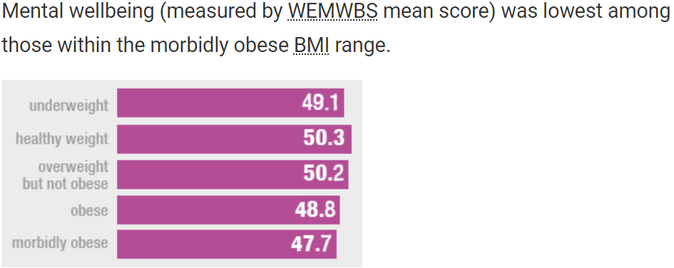
Swiss Re IP Claim Deep Dive demonstrated mental well-being declined with rising obesity

Slide 36

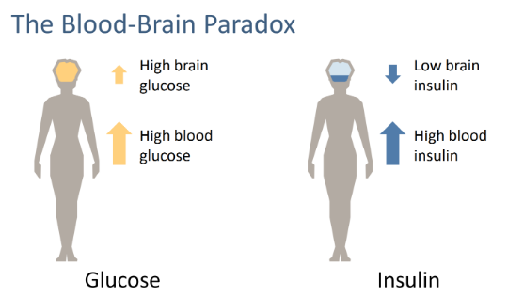
Metabolic Psychiatry
Metabolic Syndrome pre-dates BD & schizophrenia in 1 in 5 cases
Insulin resistance starts long before MetS diagnosed
Insulin resistance prevents insulin crossing BBB effectively

Slide 37
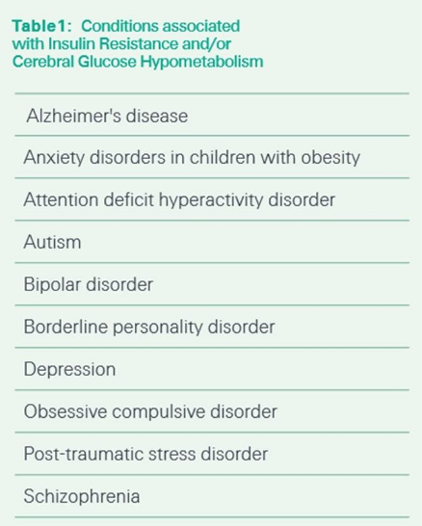
Metabolic Psychiatry
Could cerebral glucose hypometabolism help explain the rising citation of “brain fog” in Disability claims
'Association between metabolic syndrome and risk of incident dementia in UK Biobank’ – 12% higher risk of dementia with Metabolic Syndrome, 50% higher if all 5 elements existed

Slide 38
Metabolic Psychiatry – expanding research
Baszuki Group
Harvard – Dr Chris Palmer
Stanford – Professor Shebani Sethi
Cambridge – Professor Marazziti
Leiden – Dr Eline Dekeyster
Themes;
Keto diet used in BD and schizophrenia
Small RCTs – proof of concept

Slide 39

What happened in our pilot?
Join me in the breakout to find out!

Slide 40
Legal notice
©2025 Swiss Re. All rights reserved. You may use this presentation for private or internal purposes but note that any copyright or other proprietary notices must not be removed. You are not permitted to create any modifications or derivative works of this presentation, or to use it for commercial or other public purposes, without the prior written permission of Swiss Re.
The information and opinions contained in the presentation are provided as at the date of the presentation and may change. Although the information used was taken from reliable sources, Swiss Re does not accept any responsibility for its accuracy or comprehensiveness or its updating. All liability for the accuracy and completeness of the information or for any damage or loss resulting from its use is expressly excluded.

